Slide 1

JPE presentation
Active vibration isolation for Cold Finger Einstein Telescope
Huub Janssen
20-04-2023

Slide 2

JPE

Slide 3
Einstein Telescope
Einstein Telescope – ET Pathfinder
How is JPE involved?
Design of cryogenic vibration isolator.
Test evaluation.

Slide 4
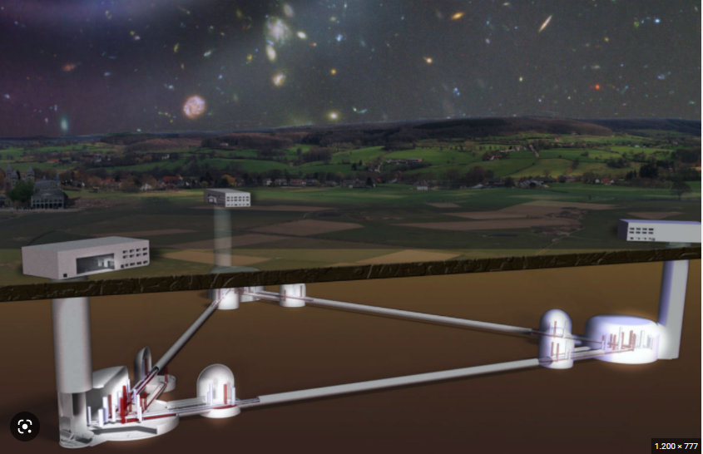
Einstein Telescope

Slide 5
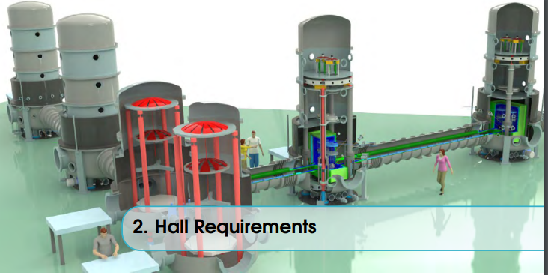
ET Pathfinder Universiteit Maastricht

Slide 6
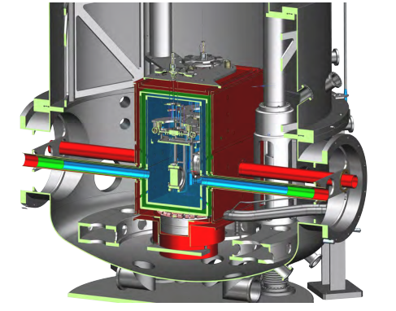
Mirror suspension

Slide 7
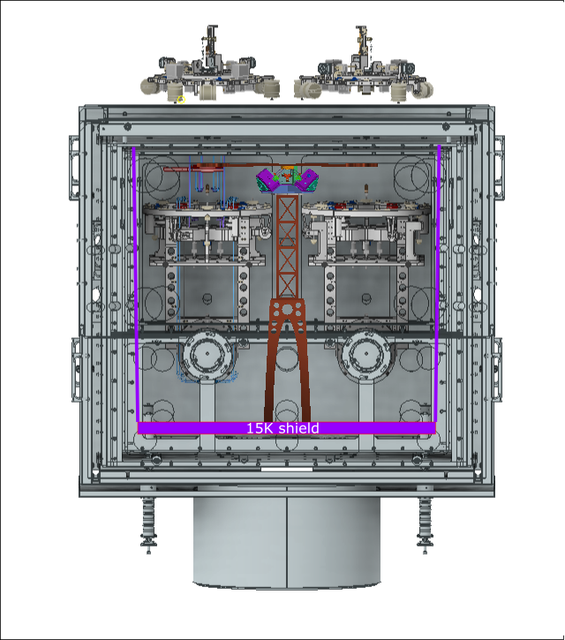
Cold finger
Cold Finger

Slide 8
How is JPE involved?
Proven track record on accurate positioning in vacuum and cryogenic environment.
In house development of cryogenic positioners with nanometric resolution.
Vibration challenges from customers in scientific research.

Slide 9
Design of cryogenic vibration isolator
Requirements
  XYZ isolation of Cold Finger
  Compact volume (250 mm diameter and 200 in height)
  Low payload mass
  Resonance frequency about 1 Hz (low pass filter)

Slide 10
Mechatronic concept
The mechanical design is based on the following key items:
Completely frictionless guides of payload mass and sensor mass by introduction of flexure elements.
Magnetic gravity compensation of sensor mass.
Force actuation by means of cryogenic compatible voice coil actuator.
Displacement measurement by means of optical interferometer.
Gravity compensation of payload mass by mechanical spring.

Slide 11
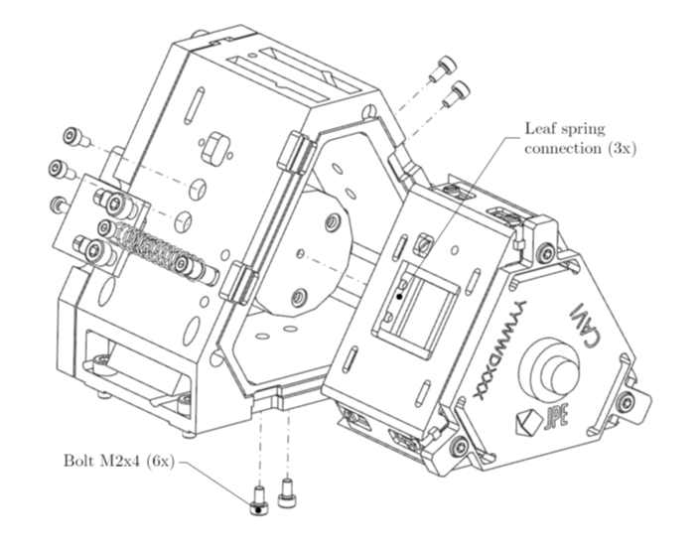
Mechanical layout

Slide 12
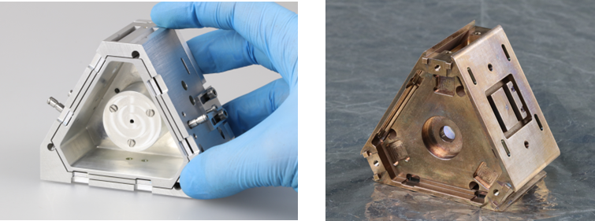
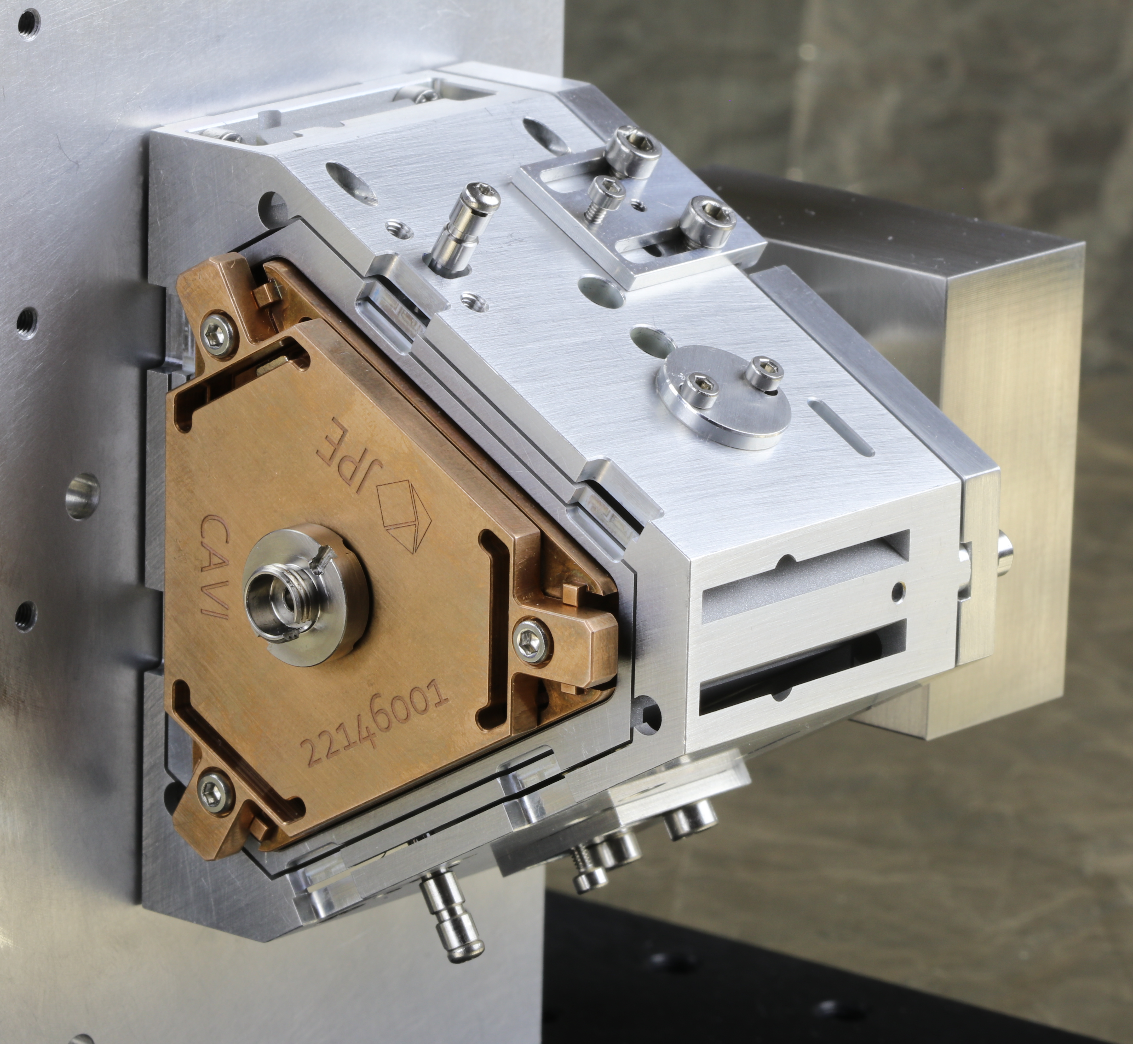
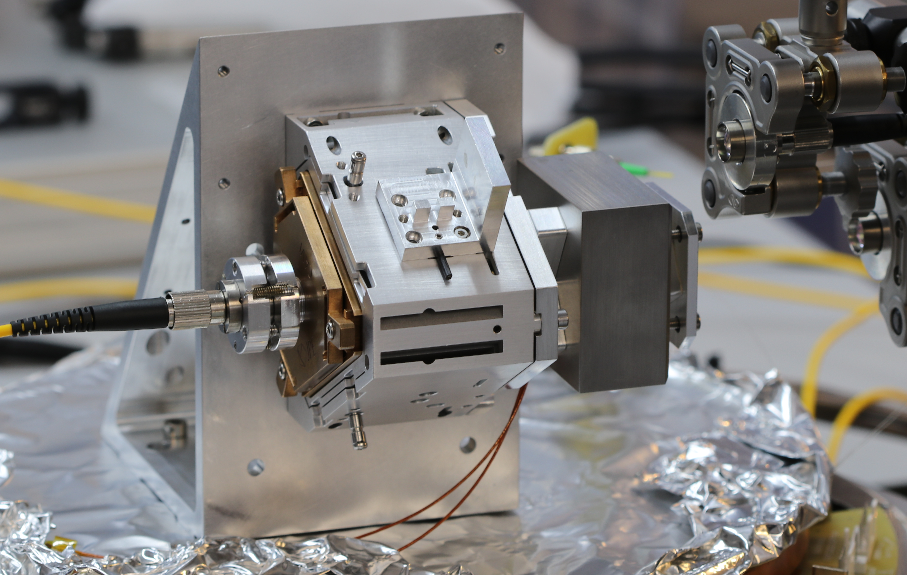
Mechanical layout

Slide 13
Test evaluation
Transmissibility = xp/xf [-] (goal: << 1)
Compliance = xp/Fd [m/N] (goal: << 1); Fd=xd * Cbraid [N]
Mirror
Xp
C braid
xd
Cold Finger
Cooler
Vibration Isolator
payload table
xf
Floor

Slide 14
Theoretical expectations
Transmissibility and Compliance
Active isolation starts at 0.33 Hz while passive isolation starts at 10 Hz
Active compliance starts at 0.33 Hz while passive compliance starts at 10 Hz

Slide 15
Measured results
Transmissibility
In passive mode: resonances of both the suspended inertial- and payload mass are present at 4 Hz and 8 Hz respectively.
In active mode: damped resonance at 0.3 Hz remaining.

Slide 16

Vibration rejection ratio – active isolation
Inverse of transmission ratio

Slide 17
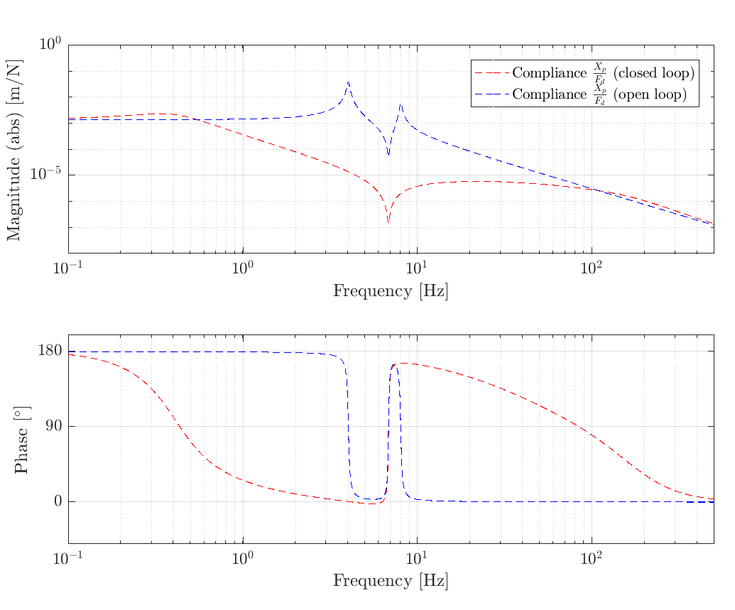
Measured results
Compliance. (predicted)

Slide 18
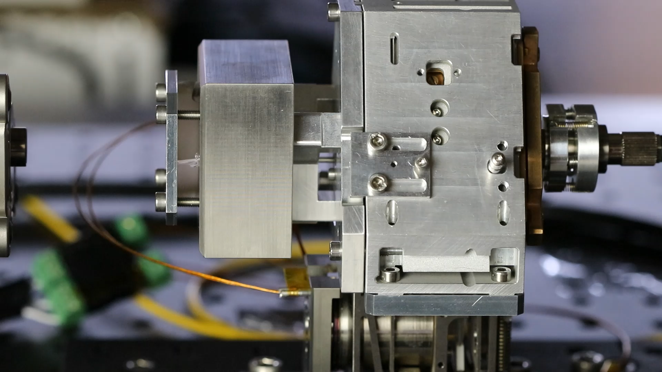

Slide 19
Conclusions
Realized a cryogenic compatible compact active isolator with a relatively small mass that is able to significantly attenuate floor vibrations and reduce disturbance forces on the payload above 0.3 [Hz]
Great improvement found of the passive to active isolation frequency:
  Passive resonance frequencies are 4 and 8 Hz with very little amount of damping
  Active effective resonance frequency around 0.3 Hz with a large amount of damping.

Slide 20
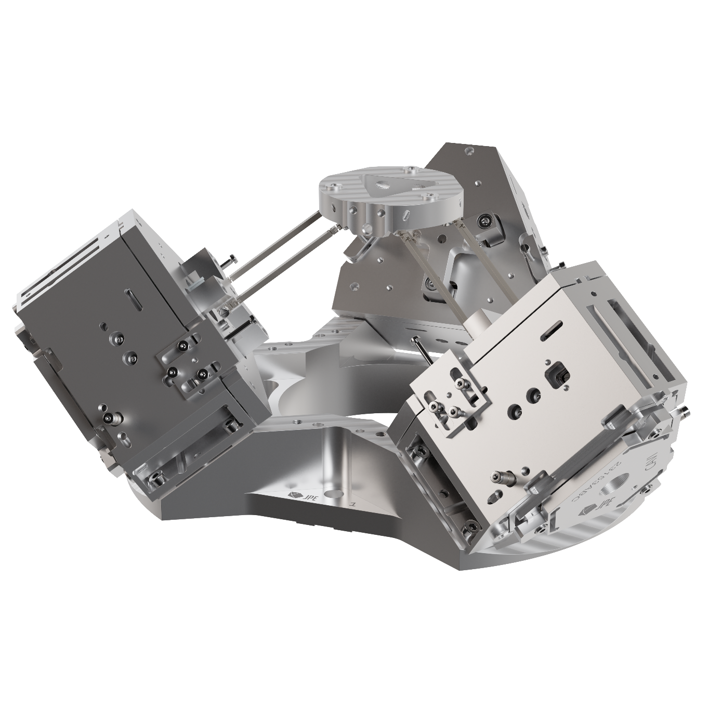
Next steps
Realization of XYZ vibration isolator

