Slide 1

Agenda ILO-net 2015

Slide 2
Terugblik 2014
SOFT 2014, 28th Symposium on Fusion Technology in San Sébastiàn
LINAC14 CERN
ICEC/ICMC TU Twente
SPIE 2014 Montreal
"The Dutch Lane" at the IPAC 2014 Dresden, Duitsland
Hannover Messe
ESS industriedag

Slide 3
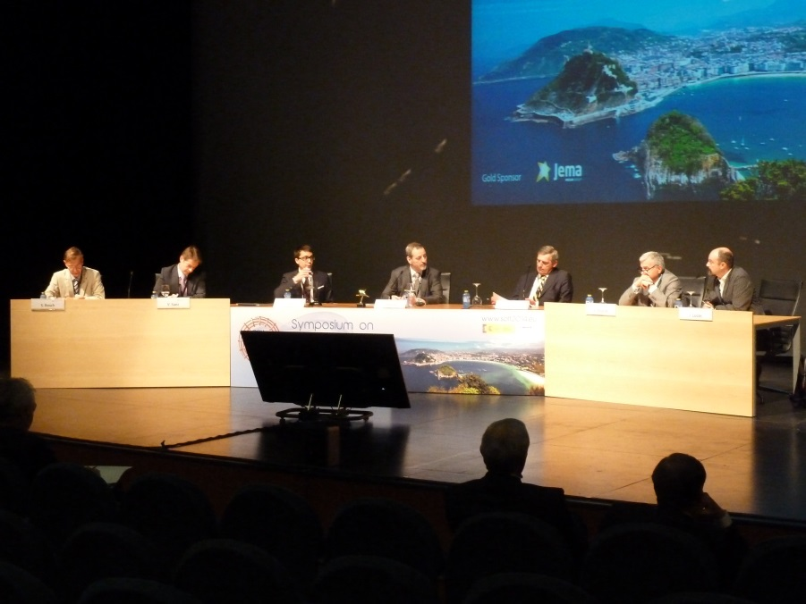
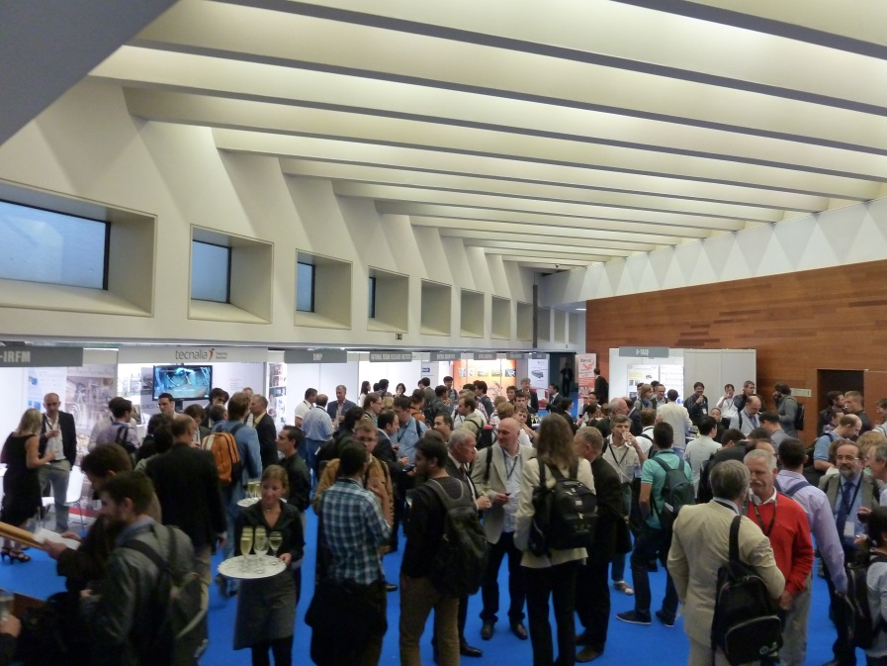
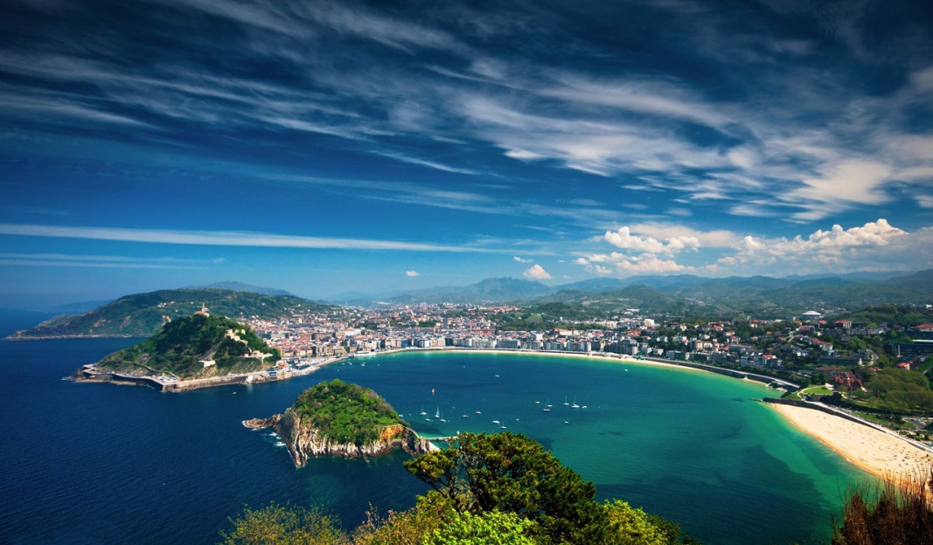
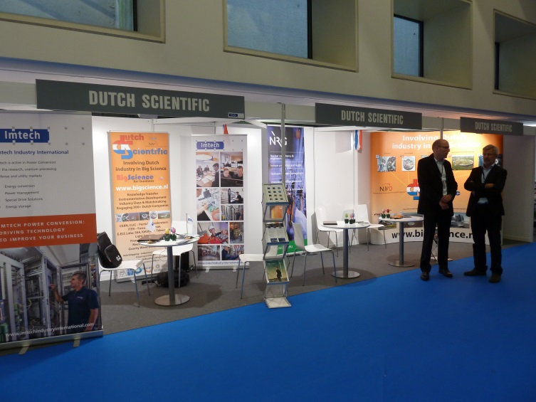
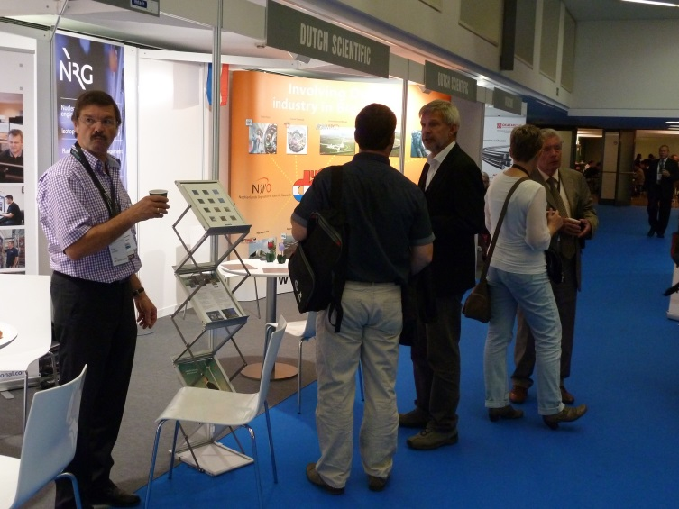


Slide 4
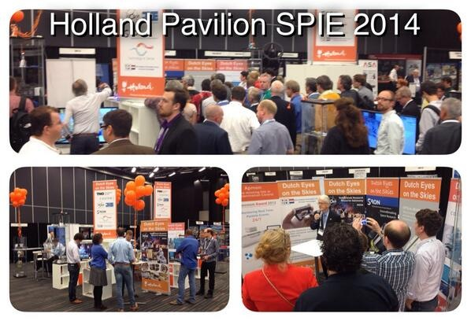
Montreal 2014

Slide 5
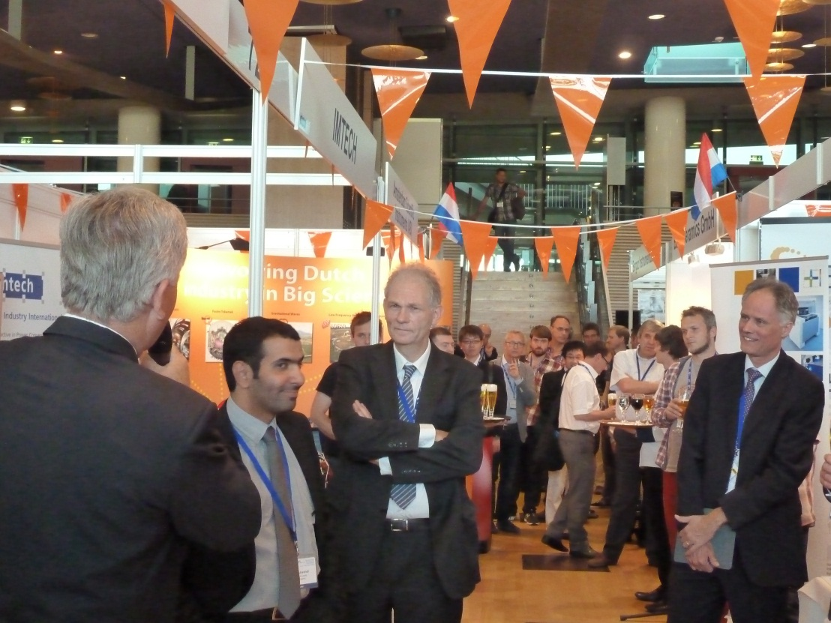
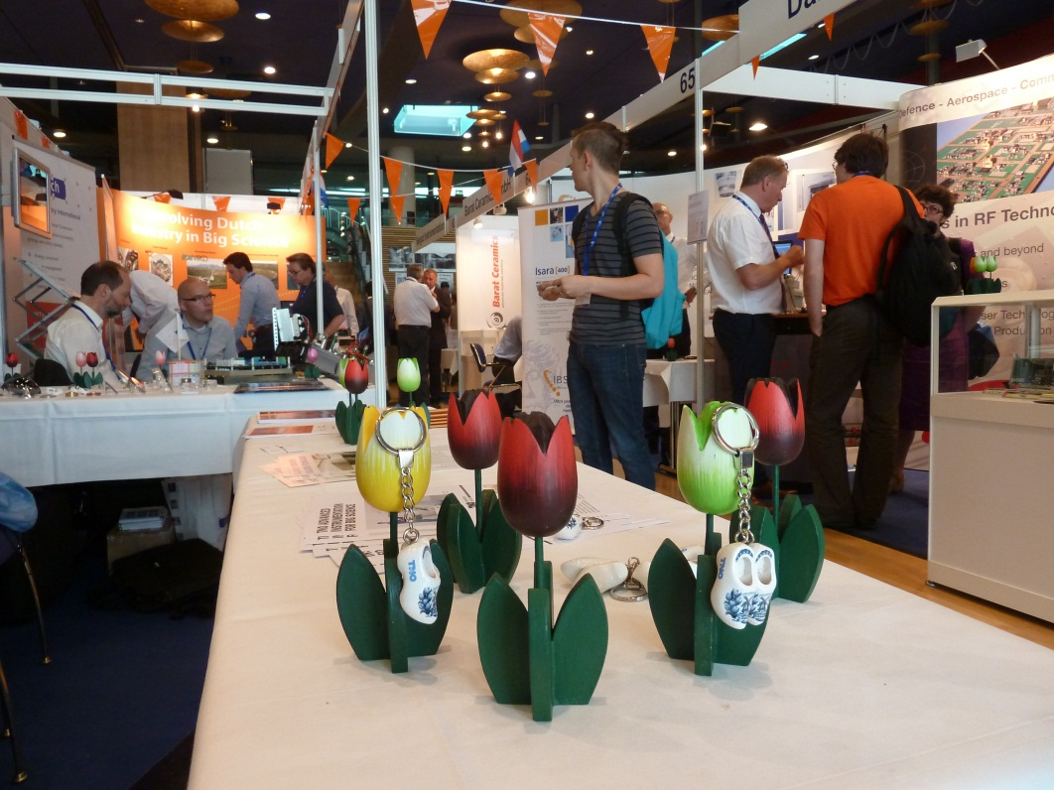
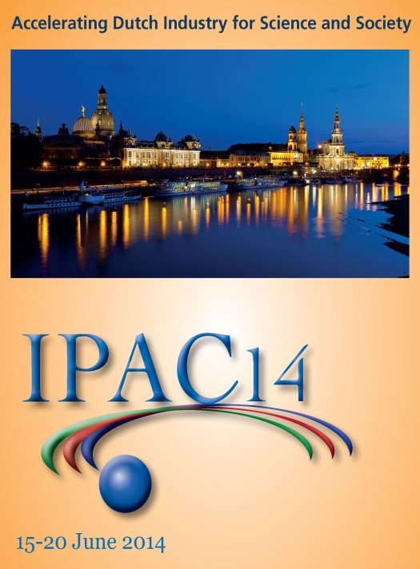
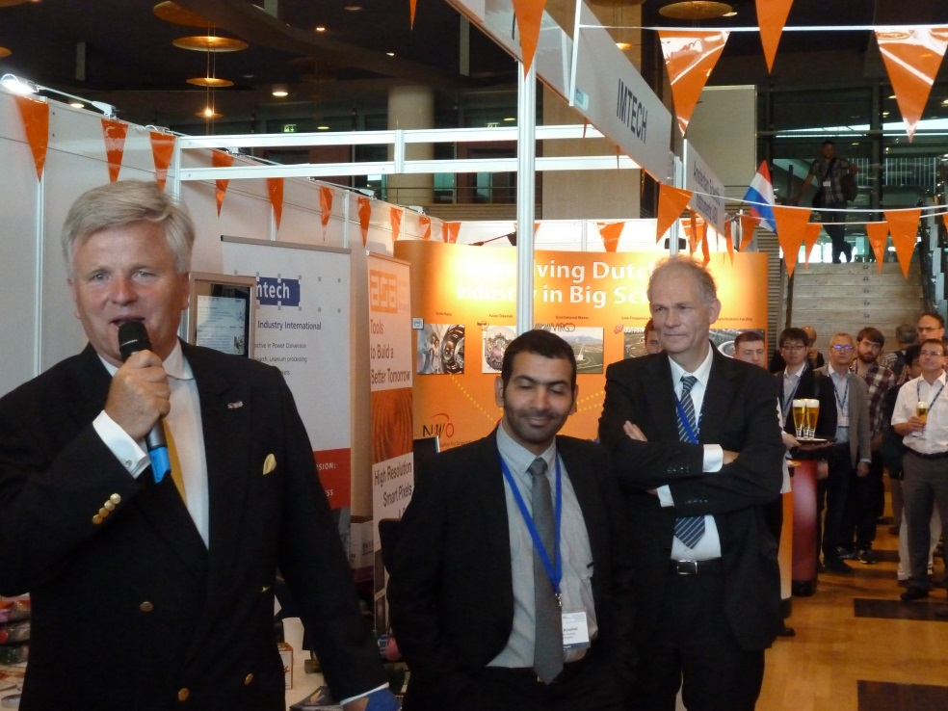
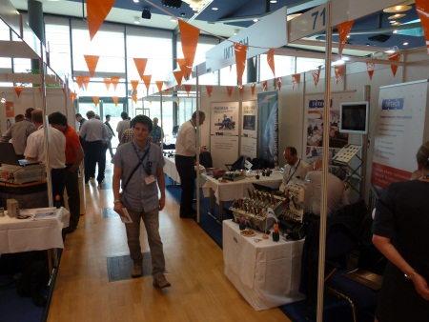
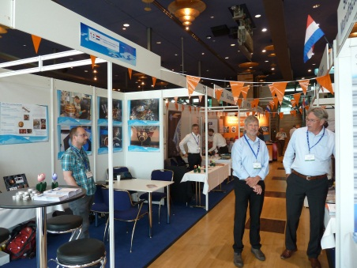
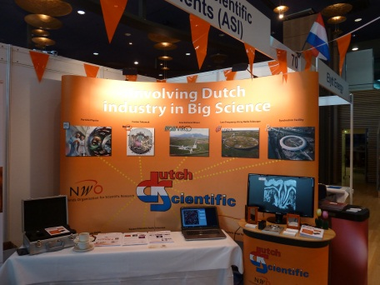

Slide 6
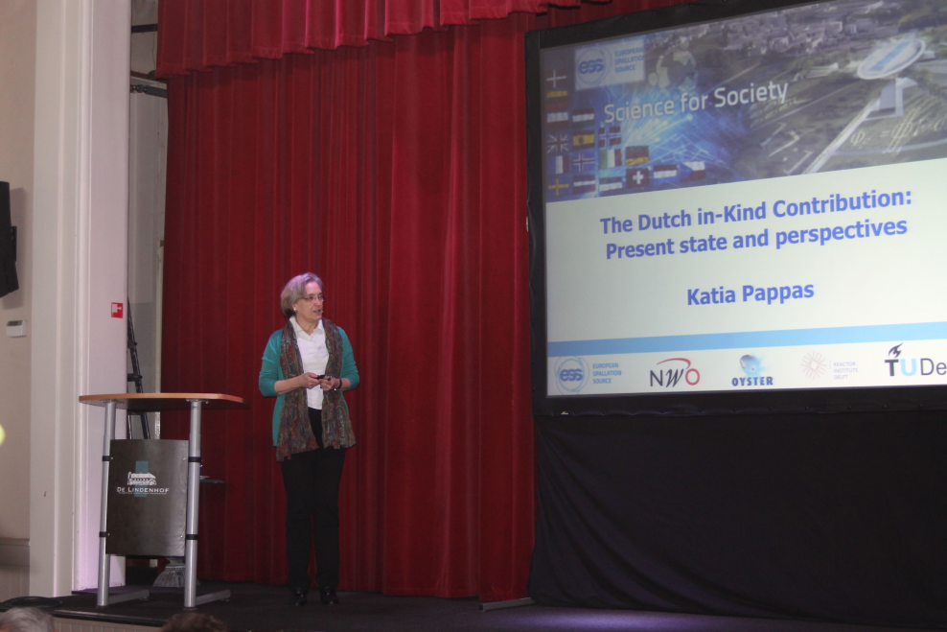
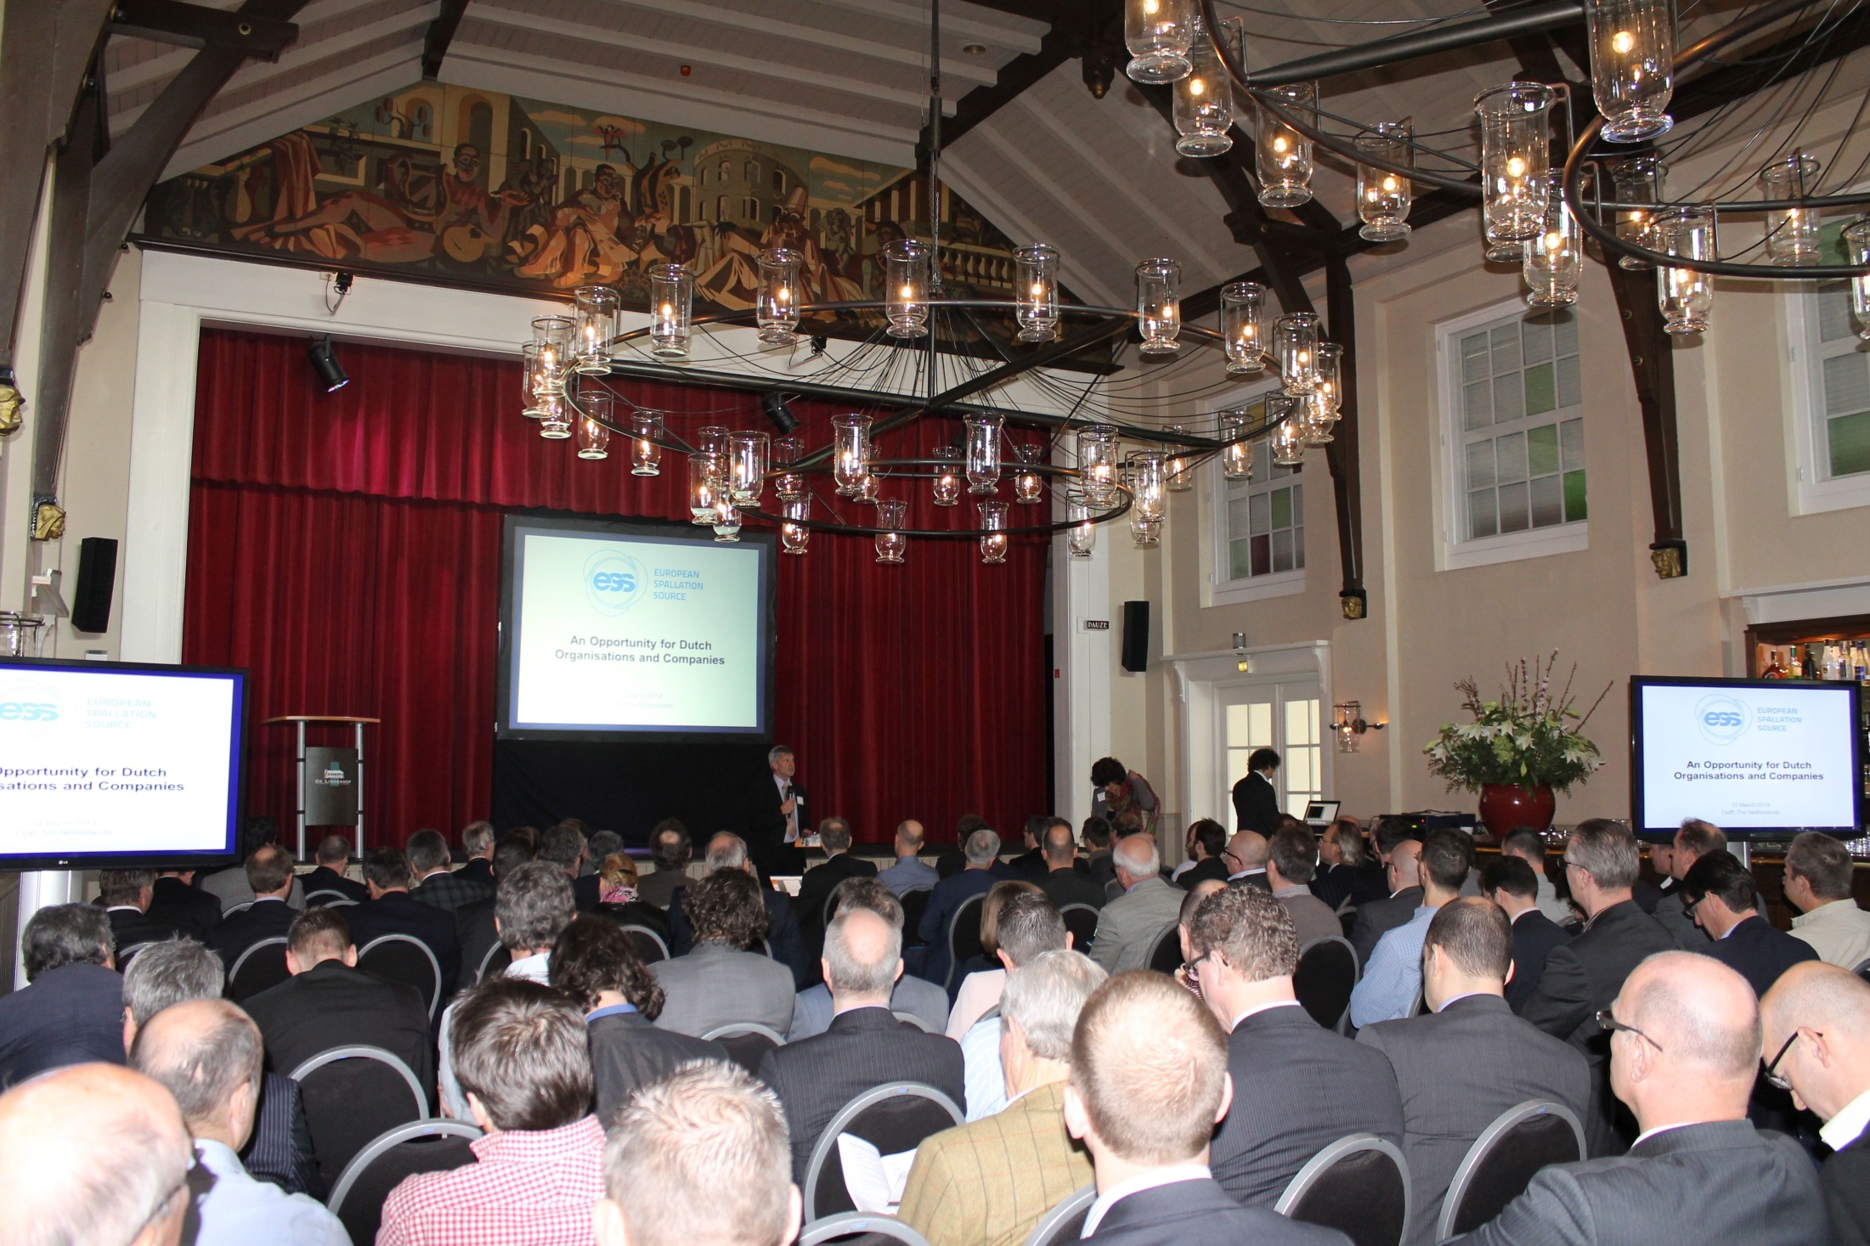
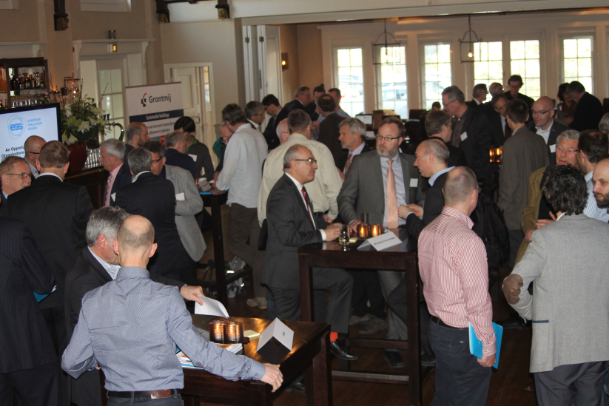

Slide 7
Evenementen 2015
ITER Business Forum
Hannover Messe
IPAC 2015 Virginia
Holland@CERN
Jaarlijkse Big Science Industriemiddag
Neutronen conferentie (ILL, ESS)
MEDSI 2015 (ESRF)
ICEC/ICMC in Arizona
Astronomen conferentie (E-ELT, SKA)
ET ontwikkel conferentie in Maastricht
Notes:
medsi2014.org in Melbourne (Mechanical Engineering Design of Synchrotron Radiation Instrumentation) 2015 in Europa bij ESRF

Slide 8
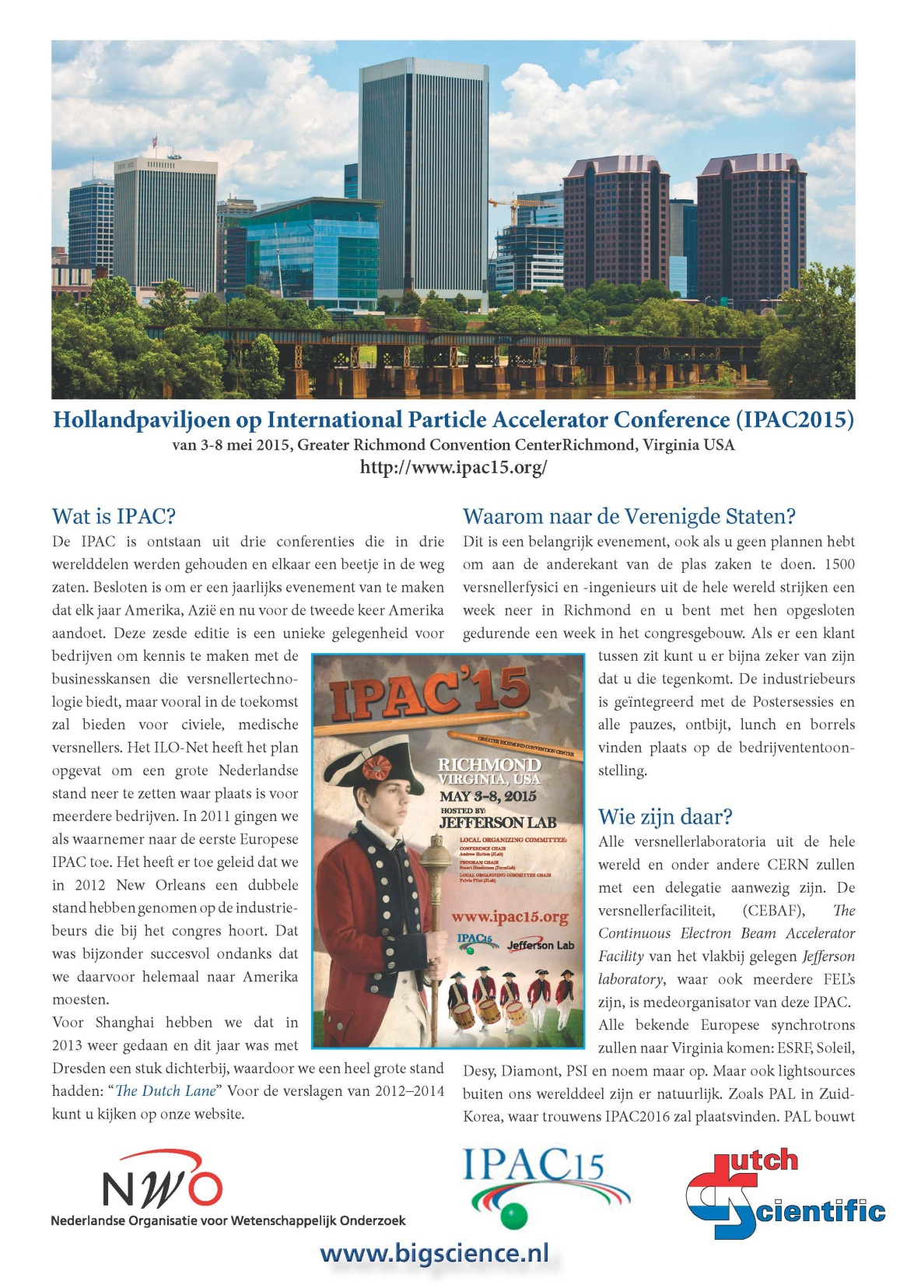

Slide 9
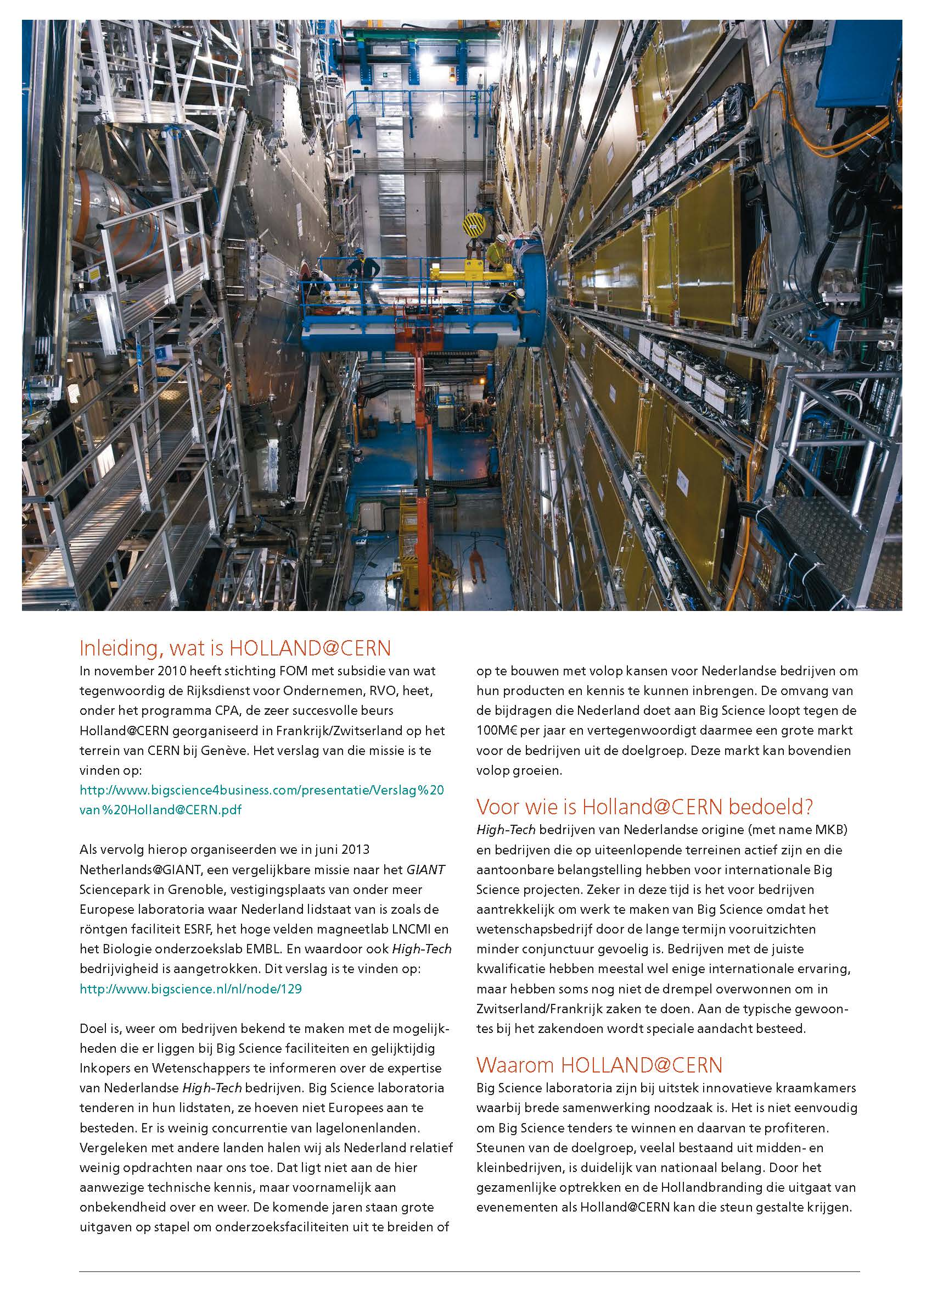

Slide 10
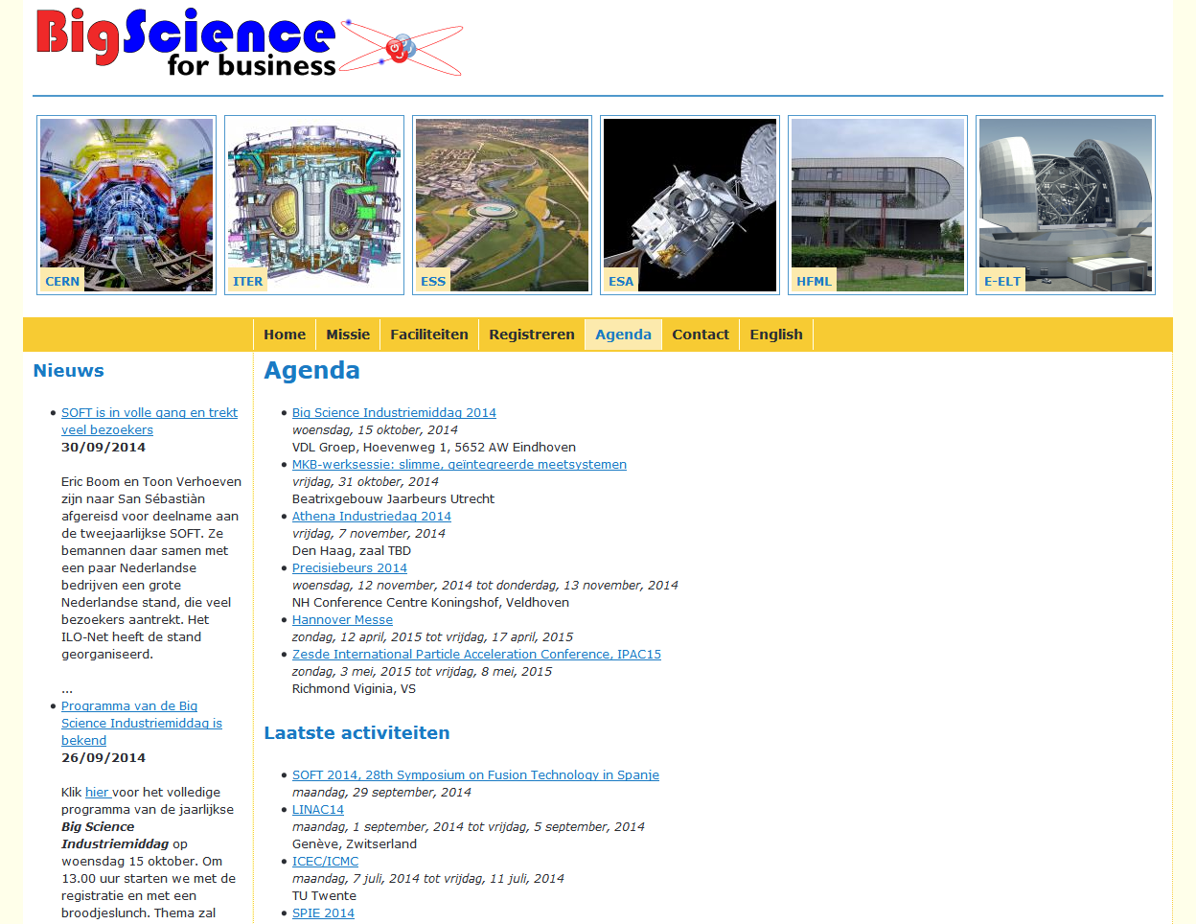
Hou de Agenda in de gaten

