Slide 1
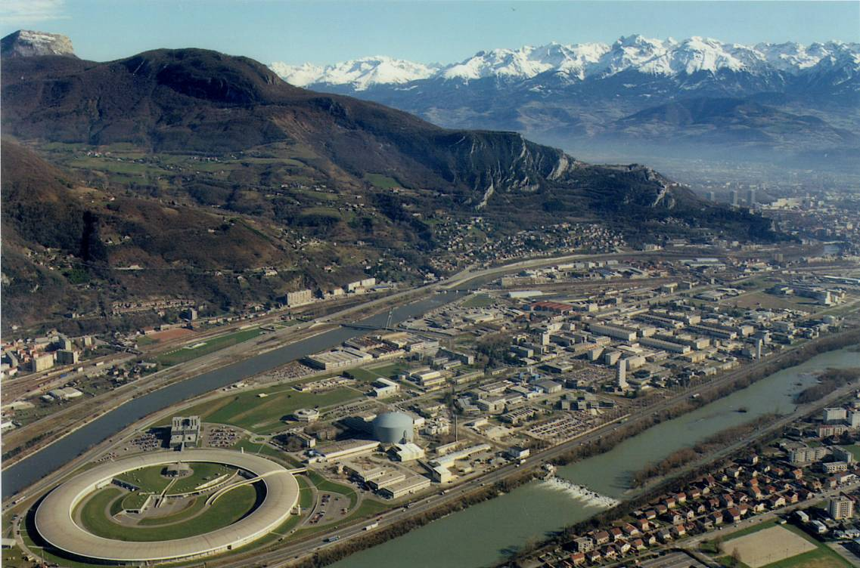
The Institut Laue-Langevin
The Institut Laue-Langevin
40 years at the forefront of neutron science
Andrew Harrison – Director General
Netherlands@GIANT – 26th June 2013

Slide 2
The Institut Laue-Langevin
The Institut Laue-Langevin
40 years at the forefront of neutron science
Trevor Forsyth – Senior Fellow & Head of Life Sciences Group
Netherlands@GIANT – 26th June 2013

Slide 3
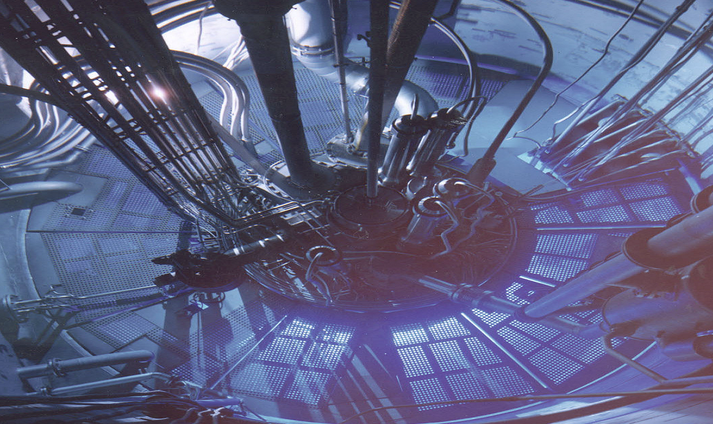
Outline
Why neutrons?
The ILL
  Past
  Present
  Future

Slide 4
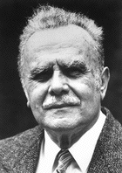
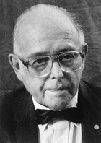
Raison d’être
A unique probe of ‘where atoms are and what atoms do’
  to paraphrase the citation for the Nobel Prize in Physics awarded to Brockhouse and Shull in 1994
Bert Brockhouse
Cliff Shull

Slide 5
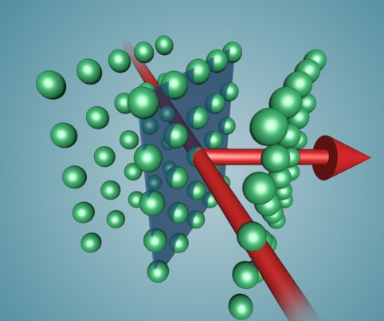
What’s special about neutrons?
Wavelength typically comparable to interatomic spacing
  Explore structure of matter from 0.001 – 1000 nm
Wavelength
Notes:
Uncharged, subatomic particles found in atomic nuclei
Approximately mass of proton, 2.2 km/s at room temperature
Wave-particle duality: wavelength = 0.18 nm at room temp.

Slide 6
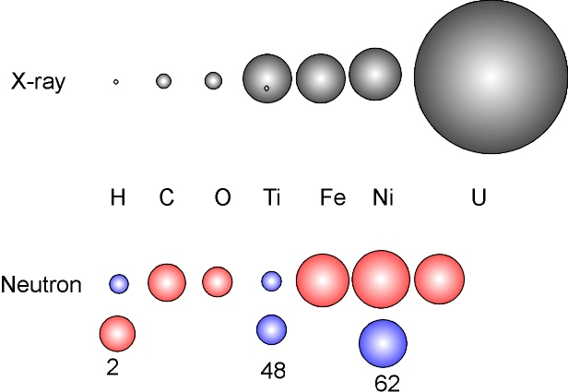
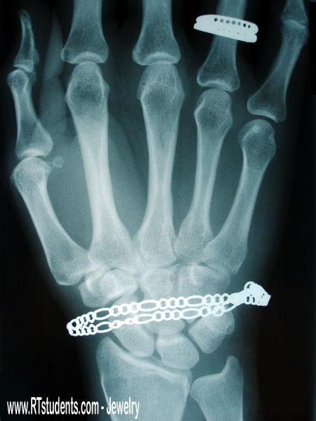
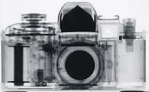
What’s special about neutrons (2) ?
Scattering different for isotopes of same element
  Neutrons can locate light atoms (H, D) very precisely
Wavelength, light atoms and isotopes
Notes:
Picture to include isotopes

Slide 7
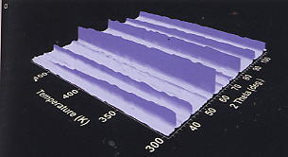
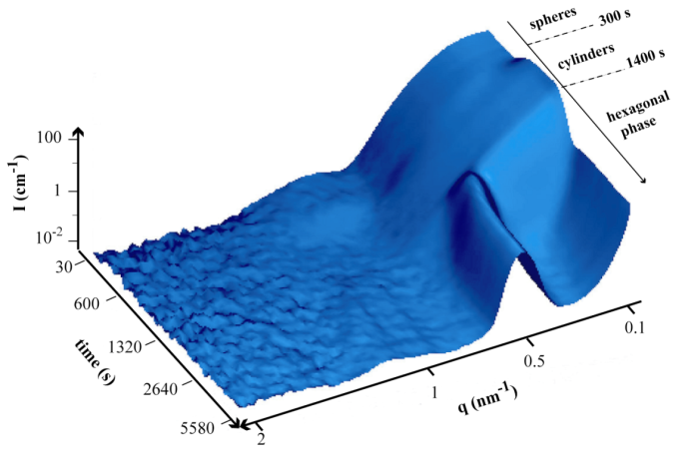
What’s special about neutrons (2) ?
Scattering different for isotopes of same element
  Neutrons can locate light atoms (H, D) very precisely – in operando
Wavelength, light atoms and isotopes
Notes:
Picture to include isotopes

Slide 8
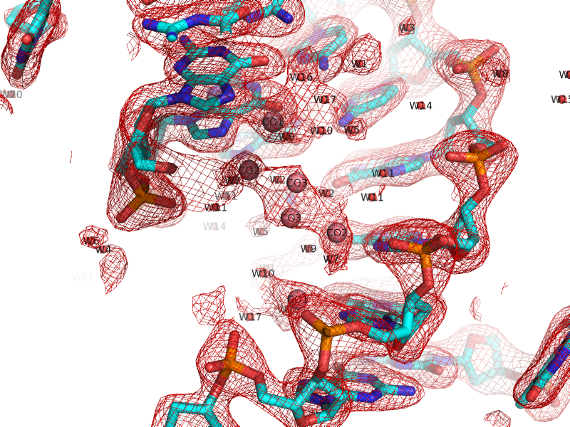
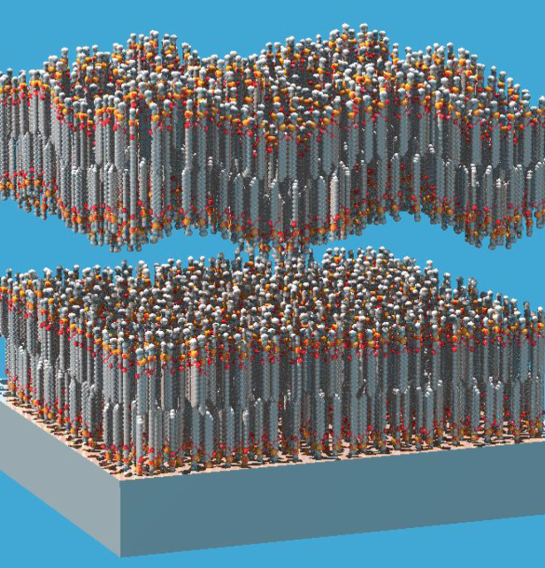
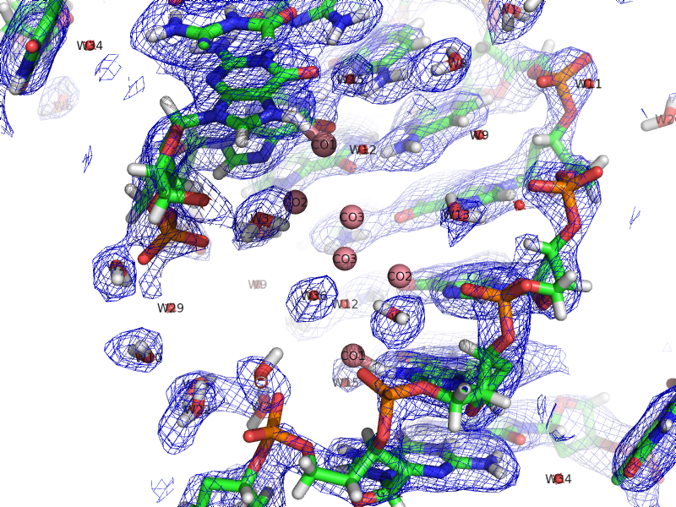
What’s special about neutrons (2) ?
Scattering different for isotopes of same element
  Key for understanding H-storage and exploitation, biomaterials…
Wavelength, light atoms and isotopes
Notes:
Picture to include isotopes

Slide 9



‘Separate’ isotopes
Scattering different for isotopes of same element
  especially hydrogen for which H and D have quite different values
Wavelength, light atoms and isotopes
Notes:
Picture to include isotopes

Slide 10

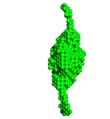
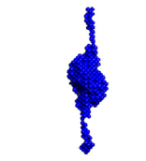


Mix and match the medium
Selectively change H for D to match H₂O/D₂O
  E.g. Enzyme that has two distinct parts (genes) to select then act (methylate) a specific DNA sequence to protect it
:
=
+
Notes:
Then have an example of globular protein -

Slide 11
What’s special about neutrons (3) ?
Neutral particles – penetrate deep in materials
Probe and map structural deformation under pressure
I
2θ,energy
d
Wavelength, light atoms and isotopes, penetration
Notes:
Several images here of engineering examples

Slide 12
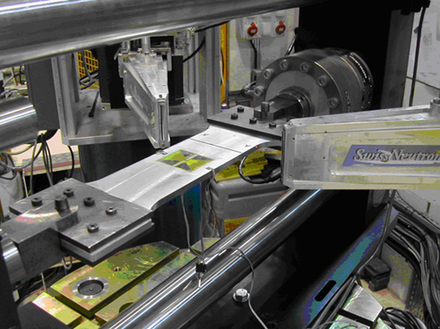
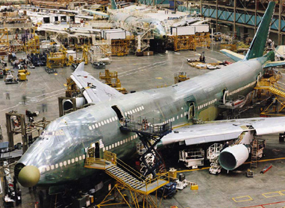
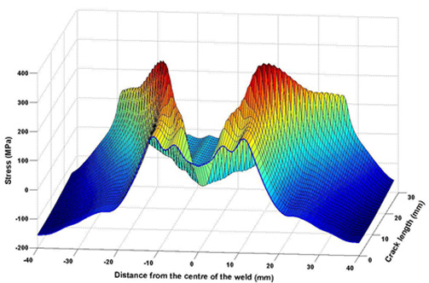
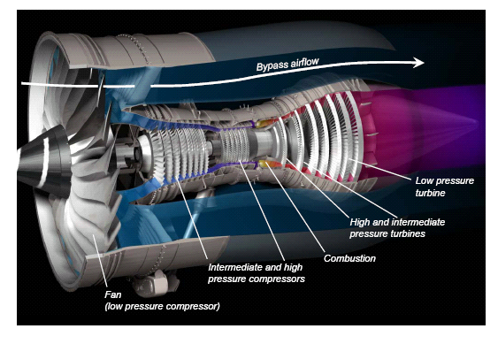
Strain scanning of critical components
Notes:
Several images here of engineering examples

Slide 13
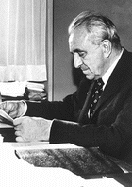
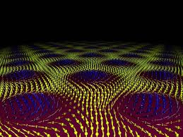
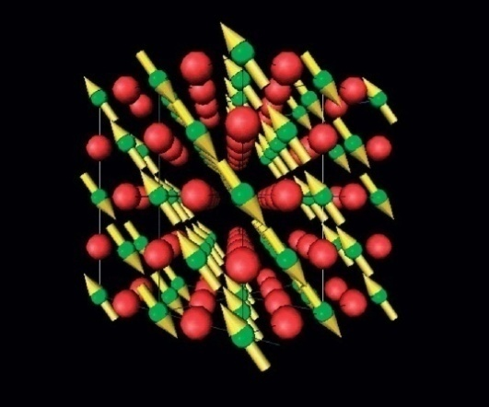
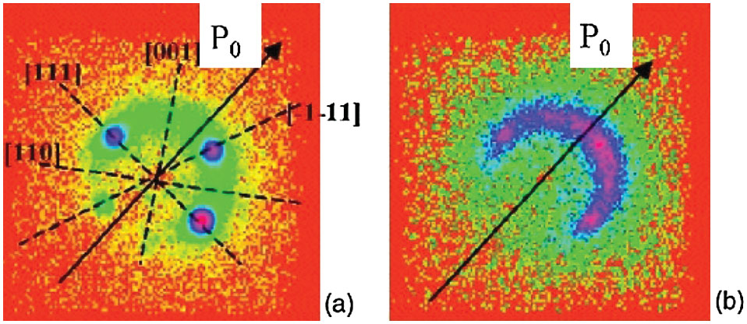
What’s so special about neutrons (4)
Magnetic moment
  Direct, unambiguous probe of magnetic structure at atomic scale
Wavelength, light atoms and isotopes, penetrating, magnetic
Notes:
Wavelength
Energy
Scattering by the nucleus
Magnetic moment and polarisation
Ability to penetrate hard matter

Slide 14
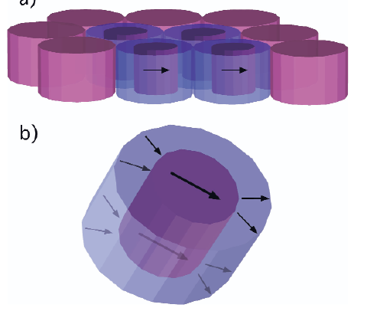
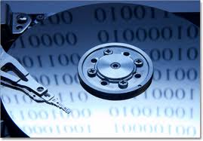
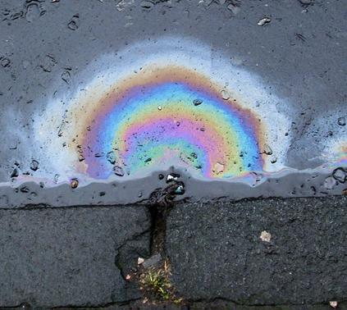
What’s so special about neutrons (4)
Magnetic moment
  Direct, unambiguous probe of magnetic structure at atomic scale
  Magnetic domains or order in nanostructures – closer to devices
Wavelength, light atoms and isotopes, penetrating, magnetic
Notes:
Wavelength
Energy
Scattering by the nucleus
Magnetic moment and polarisation
Ability to penetrate hard matter

Slide 15
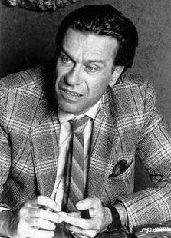
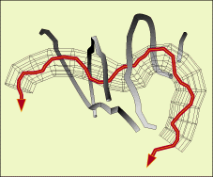
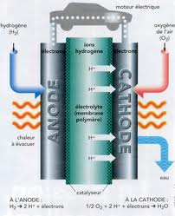

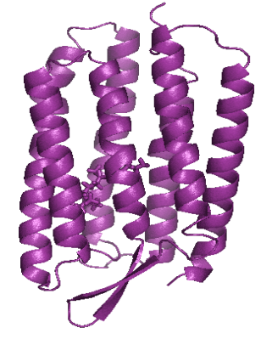
What’s special about neutrons (5)
Energy/timescale comparable to that of key processes
  Vibrations
  Molecular motion in materials and life sciences
Wavelength, light atoms and isotopes, penetrating, magnetic, energy change
Notes:
Generic figure about timescales…

Slide 16
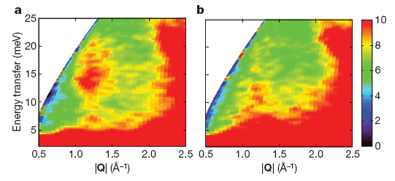
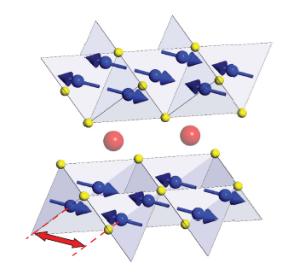
Unlocking the secret of high-T_{c} materials
26 years on…
  Converging on the origin of high-Tc superconductivity - magnetism
8 K
50 K
Wavelength, light atoms and isotopes, penetrating, magnetic
Notes:
Wavelength
Energy
Scattering by the nucleus
Magnetic moment and polarisation
Ability to penetrate hard matter

Slide 17
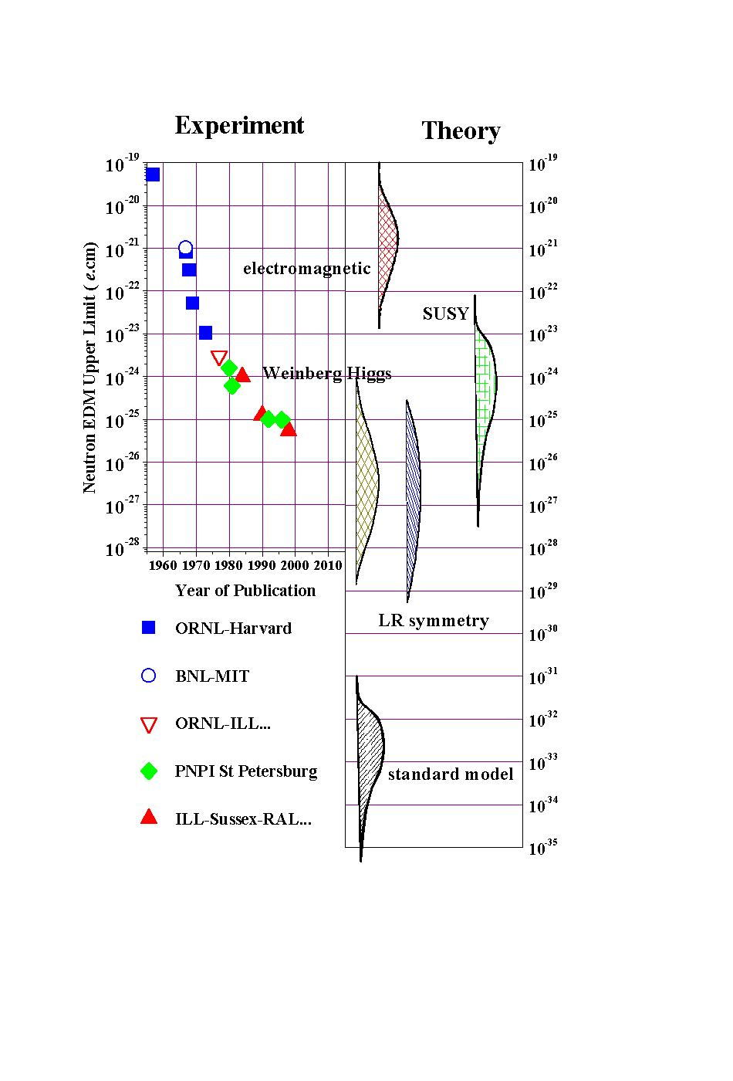
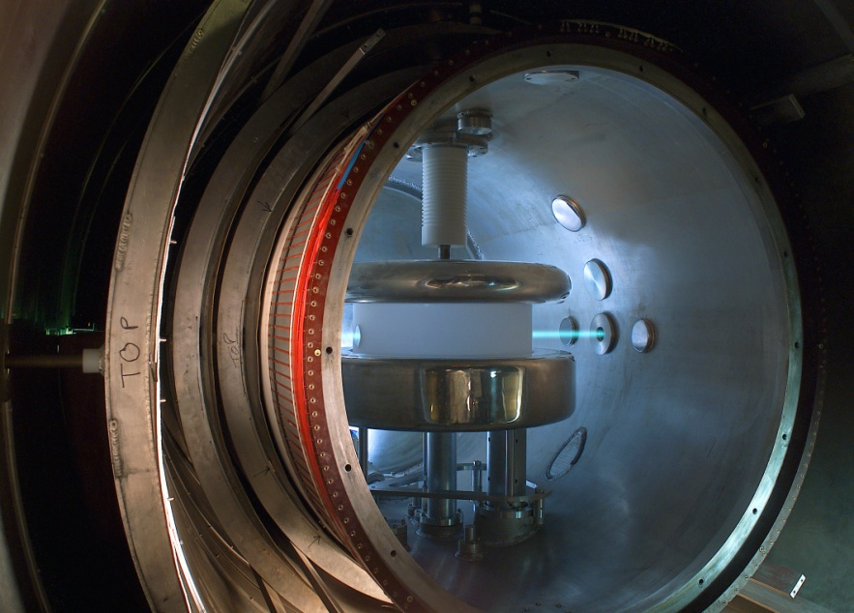
The neutron itself
Neutrons for nuclear and particle physics
Cold (meV) and ultracold (< 250 neV) neutrons as a tool to:
  challenge the standard model of particle physics
  provide essential input to understand synthesis of chemical elements in the big bang and stellar fusion

Slide 18
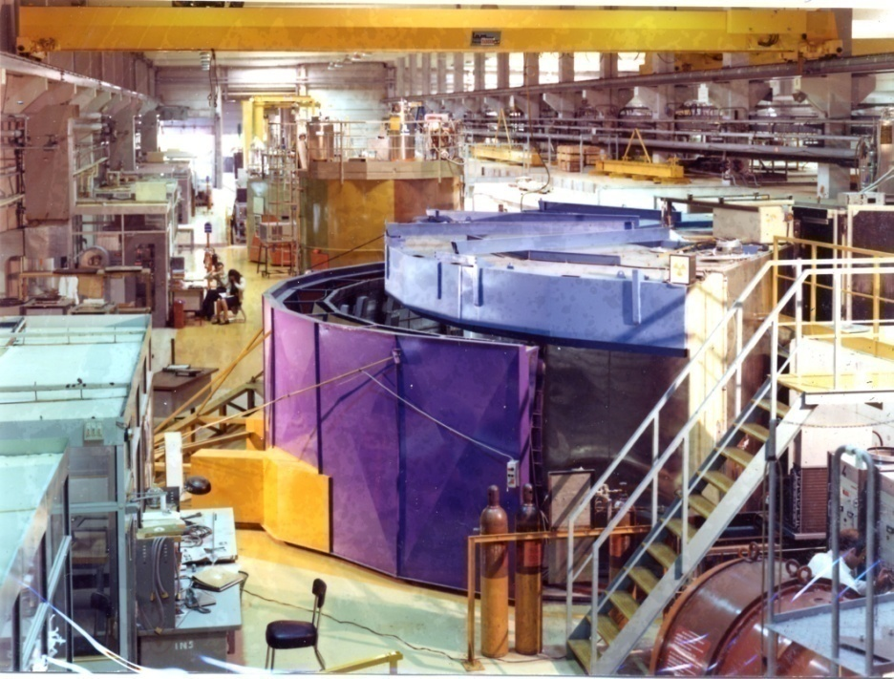
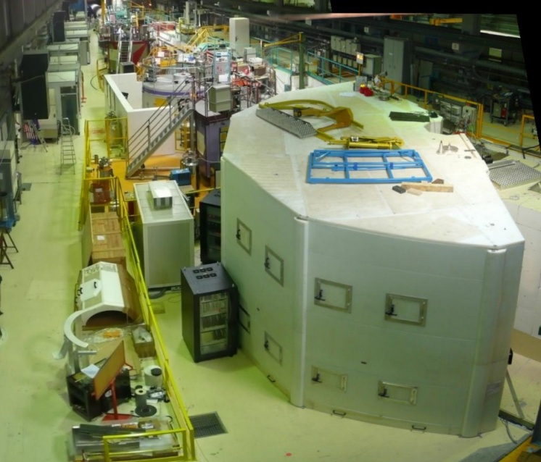
Evolution of ILL as world leader
Constant programme of instrument renewal
Image here

Slide 19
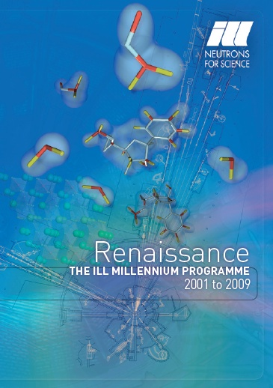
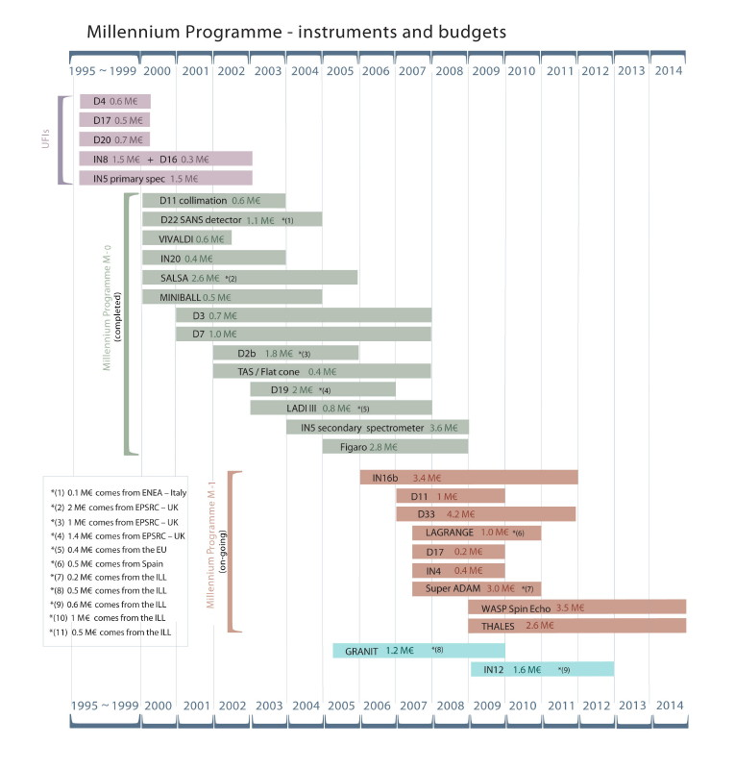
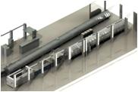
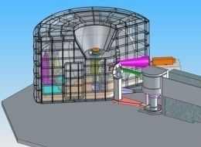



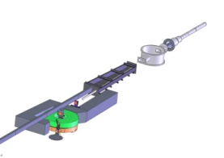
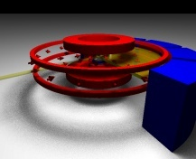
Evolution of ILL as world leader
Constant programme of instrument renewal

Slide 20
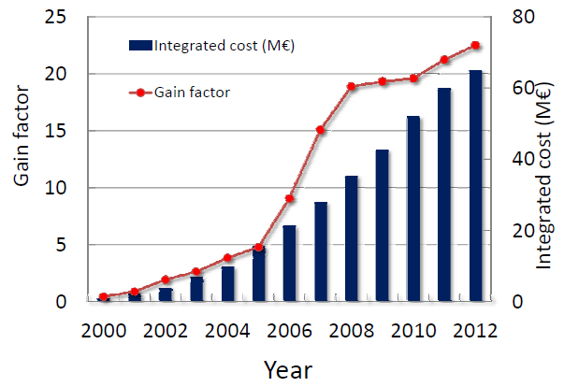
Evolution of ILL as world leader
Constant programme of instrument renewal

Slide 21
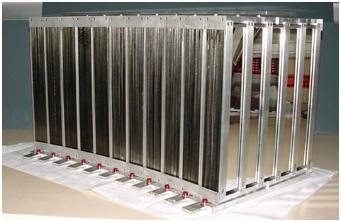
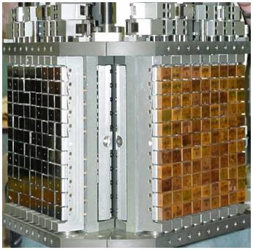
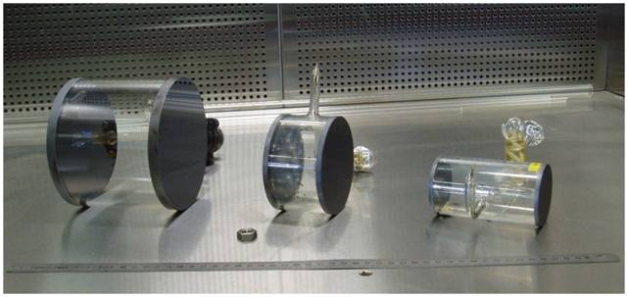
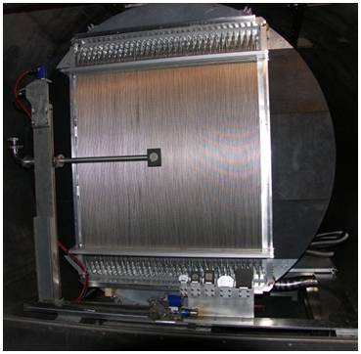
Evolution of ILL as world leader
Strong culture of technological development
Notes:
The march of civilisation is often organised according to eras or empires or even political/cultural/religious movements
(images of ‘eras’, ‘empire’ etc…renaissance, enlightenment, reason…)
It is also often organised according to the materials on which enabling technologies are based: stone, brone, irom (of which there are two – classic images of the industrial age), silicon,… (what next – probably nowhere near as snappy – biomimetic, nanostructures….)
Approx dates – Brtish Isles
Stone – 7000 – 2000 BC
Bronze – 2000 – 600 BC
Iron – (c.500 B.C - 400 A.D )
Again images
One of the key driving forces in fundamental science is to better understand how materials work and this in turn requires detailed knowledge and understanding of where the atoms and molecules are and how they move. In this talk I will tell you about one of the most powerful tools in this search, and some the amazing discoveries it has made. That tool is neutron scattering.
Perhaps just speak this – and images of stone, bronze, iron … iron (i) … silicon … ??? Dilithium

Slide 22
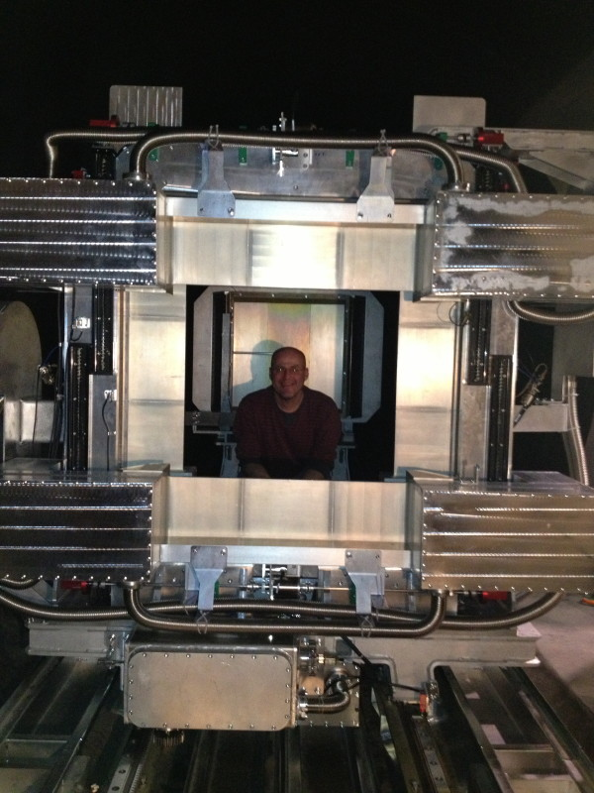
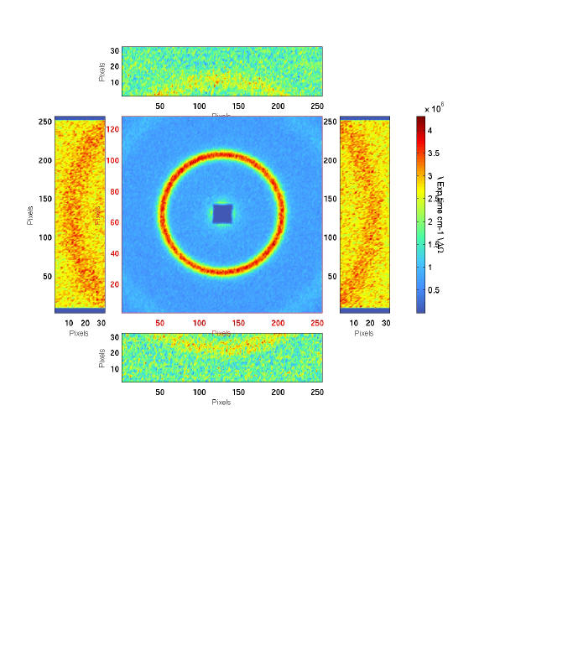
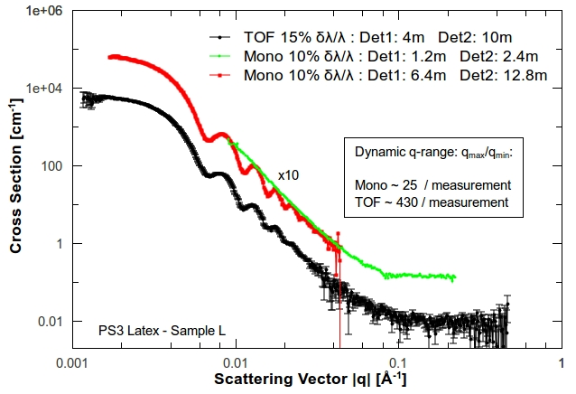
D33
Du nouveau
  4 détecteurs latéraux pour étendre la gamme de (q)
  En mode monochromatique q_{max}/q_{min} de 12 à 25
  En mode temps de vol 100-1000
Notes:
Middle picture – silver behenate powder d around 56 Angstroms – first order on rear detector, second order on front/side detector
RHS latex spheres in D2o showing mono and ToF modes and the q-dynamic range (mono at two settings)

Slide 23

Le projet H5 des guides pour ILL22.
Grand arrêt 2013-2014

Slide 24


Thales et WASP
Deux instruments pour 2015
  Un spin echo WASP (IN11 fermé)
  Un trois axes Thales (IN14 fermé)

Slide 25



Un vie après l’³He
Un nouveau type de detecteur à base de Bore (B₄C)
¹⁰B₄C layers
(1 µm)
Al substrate (0.5 mm)
neutrons
Fission fragments
neutrons
Gas mixture
Neutron conversion in ¹⁰B :
neutrons
ILL, ESS, Lingöpings, Perugia (FP7)
Notes:
10B solid-state – trick with films is to ensure there’s enough ‘stuff’ in the beam. Each 10B struck by n produces two ionising particles – 7Li and alpha emitted in opposite directions which then ionise gas (Ar-CO2)
There are effectively dozens of layers in the flight path- detection efficiency about 55%

Slide 26






More than simply neutrons
Development of Partnerships and support services
  Deuteration Laboratory and Partnership for Structural Biology
Notes:
The march of civilisation is often organised according to eras or empires or even political/cultural/religious movements
(images of ‘eras’, ‘empire’ etc…renaissance, enlightenment, reason…)
It is also often organised according to the materials on which enabling technologies are based: stone, brone, irom (of which there are two – classic images of the industrial age), silicon,… (what next – probably nowhere near as snappy – biomimetic, nanostructures….)
Approx dates – Brtish Isles
Stone – 7000 – 2000 BC
Bronze – 2000 – 600 BC
Iron – (c.500 B.C - 400 A.D )
Again images
One of the key driving forces in fundamental science is to better understand how materials work and this in turn requires detailed knowledge and understanding of where the atoms and molecules are and how they move. In this talk I will tell you about one of the most powerful tools in this search, and some the amazing discoveries it has made. That tool is neutron scattering.
Perhaps just speak this – and images of stone, bronze, iron … iron (i) … silicon … ??? Dilithium

Slide 27




More than simply neutrons
Making neutrons accessible to new communities
  Deuteration Laboratory and Partnership for Structural Biology
  Facility for Materials Engineering
  Partnership for Soft Condensed Matter
Notes:
The march of civilisation is often organised according to eras or empires or even political/cultural/religious movements
(images of ‘eras’, ‘empire’ etc…renaissance, enlightenment, reason…)
It is also often organised according to the materials on which enabling technologies are based: stone, brone, irom (of which there are two – classic images of the industrial age), silicon,… (what next – probably nowhere near as snappy – biomimetic, nanostructures….)
Approx dates – Brtish Isles
Stone – 7000 – 2000 BC
Bronze – 2000 – 600 BC
Iron – (c.500 B.C - 400 A.D )
Again images
One of the key driving forces in fundamental science is to better understand how materials work and this in turn requires detailed knowledge and understanding of where the atoms and molecules are and how they move. In this talk I will tell you about one of the most powerful tools in this search, and some the amazing discoveries it has made. That tool is neutron scattering.
Perhaps just speak this – and images of stone, bronze, iron … iron (i) … silicon … ??? Dilithium

Slide 28
ILL today
500 staff
4500 users
1400 Proposals in 2011
2000 User visits in 2011
800 Experimental sessions
200 reactor days (99% beam)
37 (+10) Neutron instruments (+CRGs)
600 Refereed scientific pub’ns
Notes:
Add graph that shows distribution

Slide 29

ILL today
500 staff
4500 users
1400 Proposals in 2011
2000 User visits in 2011
800 Experimental sessions
200 reactor days (99% beam)
37 (+10) Neutron instruments (+CRGs)
600 Refereed scientific pub’ns
Notes:
The march of civilisation is often organised according to eras or empires or even political/cultural/religious movements
(images of ‘eras’, ‘empire’ etc…renaissance, enlightenment, reason…)
It is also often organised according to the materials on which enabling technologies are based: stone, brone, irom (of which there are two – classic images of the industrial age), silicon,… (what next – probably nowhere near as snappy – biomimetic, nanostructures….)
Approx dates – Brtish Isles
Stone – 7000 – 2000 BC
Bronze – 2000 – 600 BC
Iron – (c.500 B.C - 400 A.D )
Again images
One of the key driving forces in fundamental science is to better understand how materials work and this in turn requires detailed knowledge and understanding of where the atoms and molecules are and how they move. In this talk I will tell you about one of the most powerful tools in this search, and some the amazing discoveries it has made. That tool is neutron scattering.
Perhaps just speak this – and images of stone, bronze, iron … iron (i) … silicon … ??? Dilithium

Slide 30


…and new partner countries
France, Germany, UK
Scientific Partners
  Spain 1987
  Switzerland 1988
  Austria 1990
  Russia 1996
  Italy 1997
  Czech Rep 1999
  Sweden,Hungary 2005
  Belgium, Poland 2006
  Slovakia, Denm’k 2009
  India 2011
Now cover 96% of EU
Member of EIROForum – chair 2012-2013

Slide 31

ILL and the Netherlands
Beam-time applications around the 0.5 % level – in collaboration with scientists from member countries
    - Registered users
AMSTERDAM 14
DELFT 38
EINDHOVEN 14
GRONINGEN 7
LEIDEN 12
NIJMEGEN 7
NOORDWIJK 1
PETTEN 6
TWENTE 4
UTRECHT 10
WAGENINGEN 24
137
Notes:
Complete with blobs to indicate size of community

Slide 32




A changing world
ISIS + TSII
SNS Oak Ridge
J-PARC Tokai
FRM-II Munich
Notes:
The march of civilisation is often organised according to eras or empires or even political/cultural/religious movements
(images of ‘eras’, ‘empire’ etc…renaissance, enlightenment, reason…)
It is also often organised according to the materials on which enabling technologies are based: stone, brone, irom (of which there are two – classic images of the industrial age), silicon,… (what next – probably nowhere near as snappy – biomimetic, nanostructures….)
Approx dates – Brtish Isles
Stone – 7000 – 2000 BC
Bronze – 2000 – 600 BC
Iron – (c.500 B.C - 400 A.D )
Again images
One of the key driving forces in fundamental science is to better understand how materials work and this in turn requires detailed knowledge and understanding of where the atoms and molecules are and how they move. In this talk I will tell you about one of the most powerful tools in this search, and some the amazing discoveries it has made. That tool is neutron scattering.
Perhaps just speak this – and images of stone, bronze, iron … iron (i) … silicon … ??? Dilithium

Slide 33

Where next ?
...and well beyond
ILL Associates’ Neutron Working Group: ILL leader in Europe for at least 15 years and planning must be joined up
ILL planning horizon: 2030

Slide 34
EU needs: now and the future
ILL Associates’ Neutron Working Group: ILL leader in Europe for at least 15 years and planning must be joined up
Even then, ILL will still lead ESS in key areas
  Long-term flux stability e.g. for kinetic measurements
  Hot neutrons
  Measurements at specific (Q,w) e.g. Cryopad
  No particular advantage with broad-band techniques e.g. NSE
Nuclear authorities indicate planning horizon of 2030
Notes:
...but need to join up planning rather than all working on separate interests...

Slide 35

Where next: 2020 Vision
Beyond the Millennium: 2020 Vision

Slide 36

Institut Laue-Langevin, Grenoble
www.ill.eu
Notes:
Better front picture

